Slide 1

Web Application for Lost and Found
Supervised by
Dr. CHEN Jianjun
Associate Professor
Computer Science and Technology
Jiangsu University Of Science & Technology
Name: Md: Aftab Uddin
Student ID: 162910701142
Computer Science and Technology
Jiangsu University Of Science & Technology
Friday, June 12, 2020
Notes:
Hello laoshimen, A pleasant morning to you all. At a time of global crisis, hope you are staying safe and well. I am very happy to have this chance to give my presentation. Before I start my presentation, let me introduce myself first. My name is MD Aftab Uddin student ID: 42, I am from Bangladesh. Today I will share my research with you and the title of my thesis presentation is Web application for Lost and Found which is supervised by Our honorable Teacher by Dr Chen Jianjun special thanks to him because without his help it was impossible to create this system He help me a lot all the time. Okay Lets talk about overview of my project.

Slide 2
Project Overview
Lost & Found is developed for the people who lost something or found something.
The lost thing or found thing can be even a person.
If something gets missing the owner post on our application or if anyone found something and want to return post on our application.
They will communicate with each other through our application.
User can make comments under a post.
Lost & Found is basically a web application which is currently built for online platform.
Notes:
In computing, a web application or web app is a client–server software application which the client or user runs in a web browser. Web applications are getting popular these days as they can be accessed from anywhere using a web browser and the convenience of using a web browser as a client to update and maintain web applications without distributing and installing software. Common web applications include webmail, online retail sales, online auctions, wikis, instant messaging services and many other functions. In this project, a web-based distributed lost-and-found service for society,
So we can see lost and found is

Slide 3
Problem description
In our daily life sometime we lost our valuable things and sometime a person get missing .
We have to struggle a lot to find that person or the things. We inform the police then make a GD.
After taking GD police run inquiries if they found they inform us but police don’t get much interest if the missing object is cheap or tinny which is very hard to find and there is no proper clue.
Sometime we make mike announcement for the missing object or person.
Most often we don’t get that thing or Person back.
Notes:
Losing your personal belongings can be a very frustrating experience. But, with an effective lost and found system, all your important items like keys, mobile phones, digital cameras, laptops, wallets, i-pods, briefcases, handbags even a person, will find their way safely back to you. Therefore, I have decided as a final year project to design and develop a new Web-based Lost and Found System.
In the problem descriptions

Slide 4
Goal
Making online system where people can make lost post and found post.
Building communication between the owner and finer to get product hand to hand.
Making a platform where people can post any type of missing thing or person. And also can make found post if anyone found something that he/she wants to give back to the owner.
So, My motive is to create a online place where people can exchange their missing things.
Notes:
Now we are going to the goal of the my project. The major goal of this project is to help the peoples with a web service to find their lost stuff more quickly. The application is an online lost and found web portal with an interactive user interface. It is a user-friendly web application which is created using web programming languages connected to the database. The project is designed using a client-server model. The main features of the web application include an authentication, registration and login system, a lost and found listings page where the user can enter the information about the lost and found items. Keeping in mind some security issues, the users cannot delete any items. The reason was some users may delete the items just to mess around. This privilege is given to the admin only. The application also allows the users to update the listed items if needed. The users can update the contact information and change the password.

Slide 5
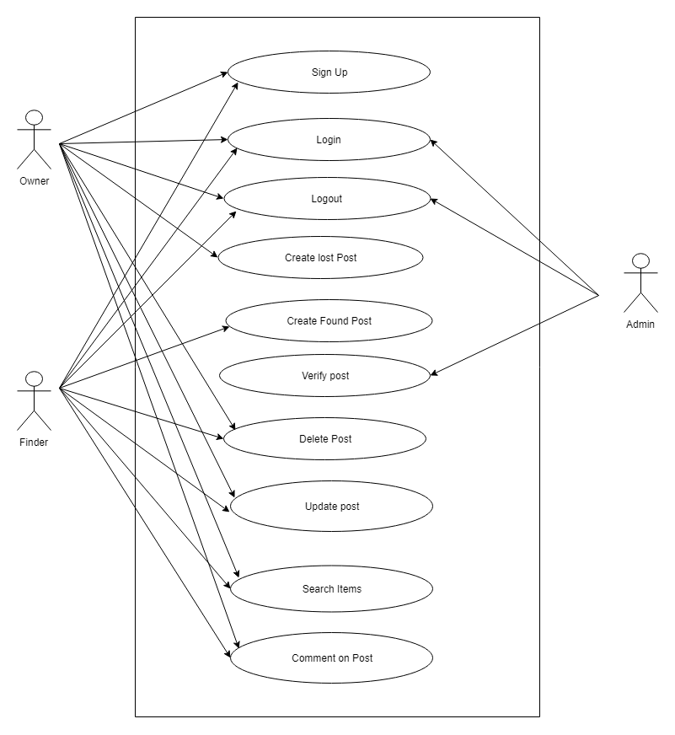
Use Case Diagram
Notes:
A use case diagram at its simplest is a representation of a user's interaction with the system that shows the relationship between the user and the different use cases in which the user is involved. A use case diagram can identify the different types of users of a system and the different use cases and will often be accompanied by other types of diagrams as well. The use cases are represented by either circles or ellipses. Here, as we can see 3 types of users 1 is admin 2nd one is owner of the lost product and other one is Finder who found the product. From here we can see admin can interact with login, logout and verify post similarly owner and finder can interact with some system.

Slide 6
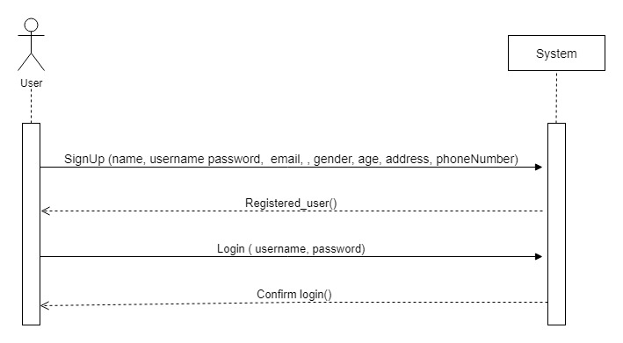
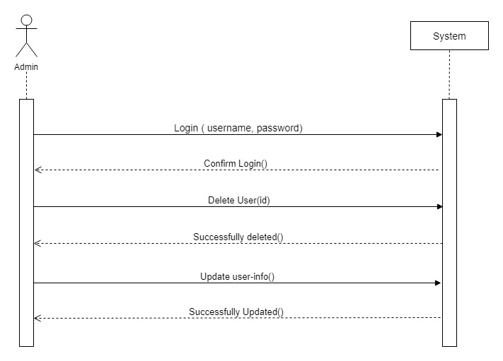
Sequence Diagram
11
User signup/login
Admin login
Friday, June 12, 2020
Notes:
Sequence Diagrams are interaction diagrams that detail how operations are carried out. They capture the interaction between objects in the context of a collaboration. Sequence Diagrams are time focus and they show the order of the interaction visually by using the vertical axis of the diagram to represent time what messages are sent and when. Here we can see if user wants to interact with system user should provide some information to system like (name, username. email) and system will do some operation and give the output to user similarly admin login

Slide 7
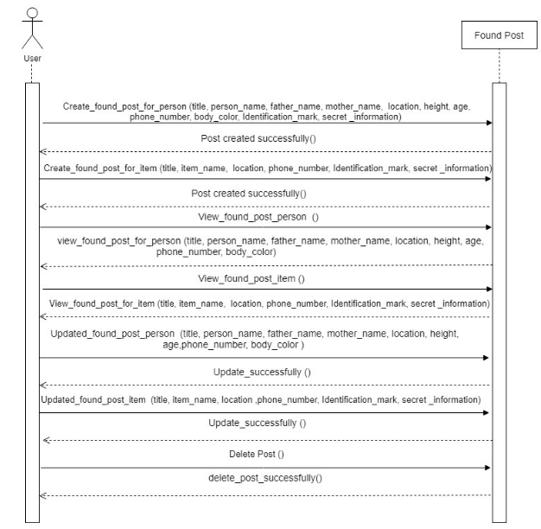
Create Found Post Sequence Diagrams

Slide 8
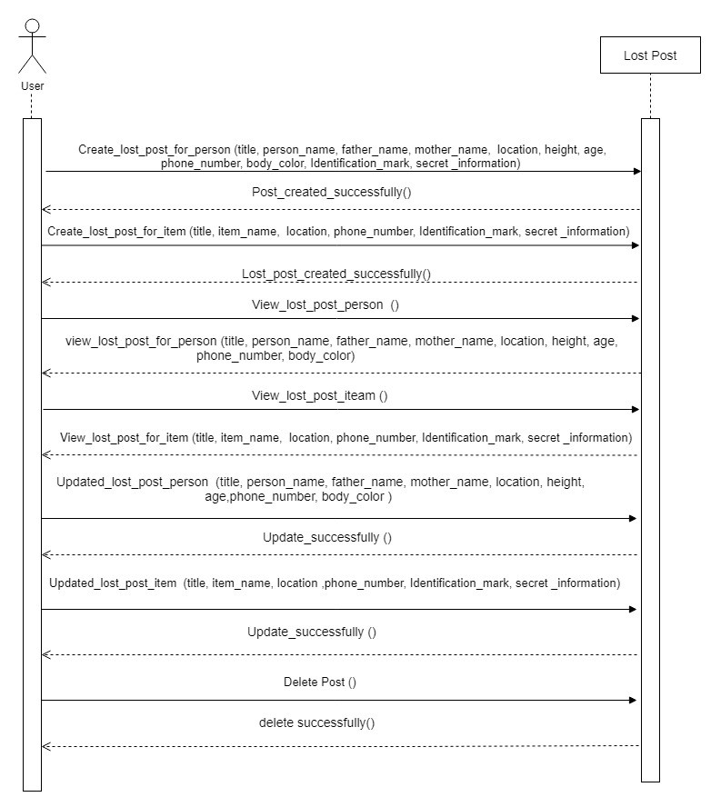
Create Lost Post Sequence Diagrams

Slide 9
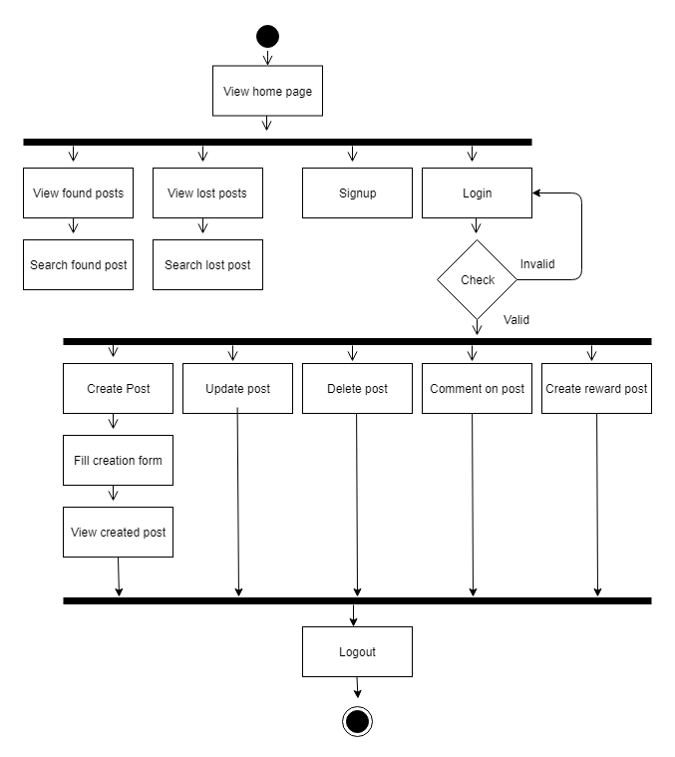
Activity Diagram:
Notes:
Activity diagram is another important diagram in UML to describe the dynamic aspects of the system.
Activity diagram is basically a flowchart to represent the flow from one activity to another activity. The activity can be described as an operation of the system.
The control flow is drawn from one operation to another. This flow can be sequential, branched, or concurrent. Activity diagrams deal with all type of flow control by using different elements such as fork, join, etc

Slide 10
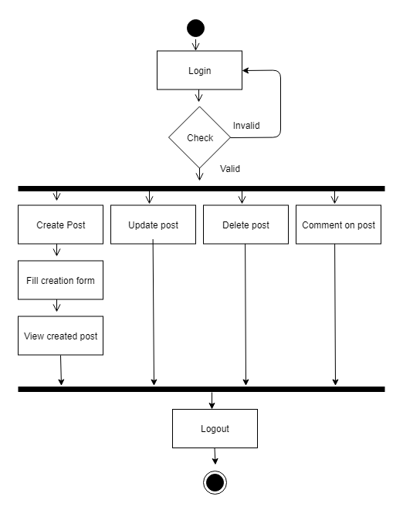
Activity diagram for finder and owner

Slide 11
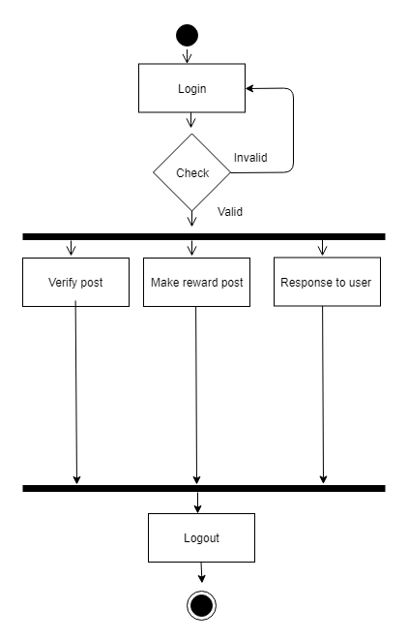
Activity diagram for admin

Slide 12
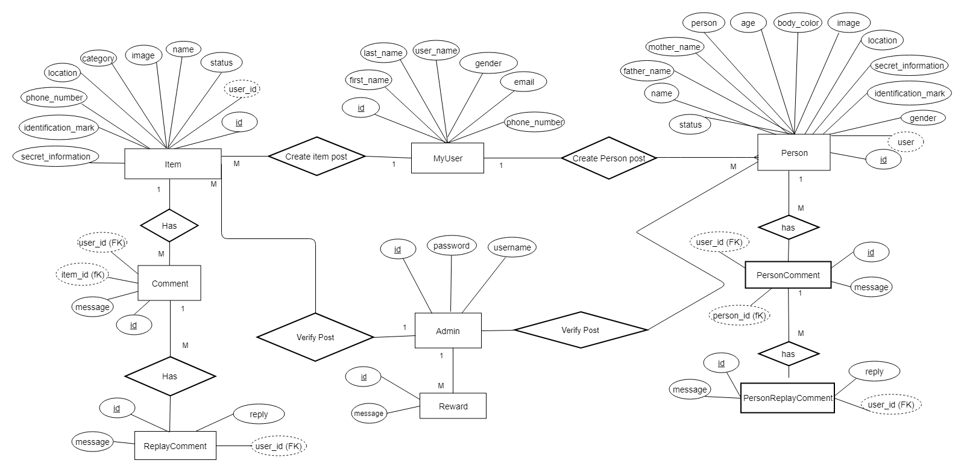
ER Diagram
Notes:
ENTITY RELATIONAL (ER) MODEL is a high-level conceptual data model diagram. ER modeling helps you to analyze data requirements systematically to produce a well-designed database. The Entity-Relation model represents real-world entities and the relationship between them. It is considered a best practice to complete ER modeling before implementing your database.
ER modeling helps you to analyze data requirements systematically to produce a well-designed database. So, it is considered a best practice to complete ER modeling before implementing your database.
In the following diagram we have several entities and for this item and my user and their relationship. The relationship between item and my user is many to one as a use can have items however a Item entity has attributes such as user_Id,Name & Location and much more and myuser entity has attributes such as ID & Gmail and much more.
Rectangle: Represents Entity sets.
Ellipses: Attributes
Diamonds: Relationship Set
Lines: They link attributes to Entity Sets and Entity sets to Relationship Set

Slide 13
Signup Test Cases
Id | ACTION | Input | Expected Result | Actual Result | Pass/Fail | Code module
1 | Sign up | First name: Ripon Last name: Sarkar Username: Rk Password: rk200cr7 Email: rk@gmail.com Gender: Male Location: Dhaka Phone number:0175615afc | Show error message phone number is invalid | Showing error message phone number is invalid | Pass | Models
2. | Sign up | First name: Ripon Last name: Sarkar Username: Rk Password: rk200cr7 Email: Gender: Male Location: Dhaka Phone number:017561545 | Show error message email field required | Showing error message email filed required | Pass | Models
3. | Sign up | First name: Ripon Last name: Sarkar Username: Rk Password: rk200cr7 Email: rk@gmail.com Gender: Male Location: Dhaka Phone number:017561545 | Signup Successful | Showing success message | Pass | Models
Notes:
Now we will see my project in the live server and test with some data.

Slide 14
Login Module Test case
Id | ACTION | Input | Expected Result | Actual Result | Pass/Fail | Code module
1 | Login | User name; Rk Password: abch20 | Show error message password don’t match | Showing error message password don’t match | Pass | Models
2. | Login | User name; Rk Password: rk200cr007 | Login successful | Showing success message | Pass | Models
2. | Login | User name; Rk Password: rk200cr007 | Login successful | Showing success message | Pass | Models

Slide 15
Search module test Case
ti | ACTION | Input | Expected Result | Actual Result | Pass/Fail | Code module
1 | Search | Search for Dhaka | Show all post of Dhaka | Showing all post of Dhaka | Pass | Views
2. | Search | Search for watch | Show all post of watch | Showing all post of watch | Pass | Views
3. | Search | Search for 1253A | Show error message invalid keyword | Showing error message invalid keyword | Fail | Views

Slide 16
Found Post test case
Id | ACTION | Input | Expected Result | Actual Result | Pass/Fail | Code module
1 | Create lost post for person | Title: Antar is missing Name: Antar mohit Phone:018665665 Email: antar@gmail.com Location: Dhaka Body color: White Father: AB mia Mother name: rupta khatun Secret information: Red eye glass Identification mark: Spot on chest. | Show success message | Showing success message | Pass | Forms and views
2. | Create lost post for item | Title: laptop is missing Name: Antar mohit Phone:018665665 Email: antar@gmail.com Location: Item name: Hp Laptop Secret information: Back side broken Identification mark: Laptop serial number | Show Error message Location field required. | Showing error message | Pass | Forms and views

Slide 17
Found Post test case
Id | ACTION | Input | Expected Result | Actual Result | Pass/Fail | Code module
1 | Create found post for person | Title: Found a person Name: Jibon Ahmed Phone:01987132107 Email: jibon@gmail.com Location: Dhaka Body color: White Father: Shakhawat Hossain Mother name: Zobida Begum Secret information: left hand problem Identification mark: Spot on chest. | Show success message | Showing success message | Pass | Forms and views
2. | Create found post for item | Title: Today I found phone Name: Jayed Hossain Phone:018665665 Email: jayed@gmail.com Location: Dhaka Item name: symphony T60 Secret information: two sim Identification mark: | Show Error Identification mark field required. | Showing error message | Pass | Forms and views

Slide 18
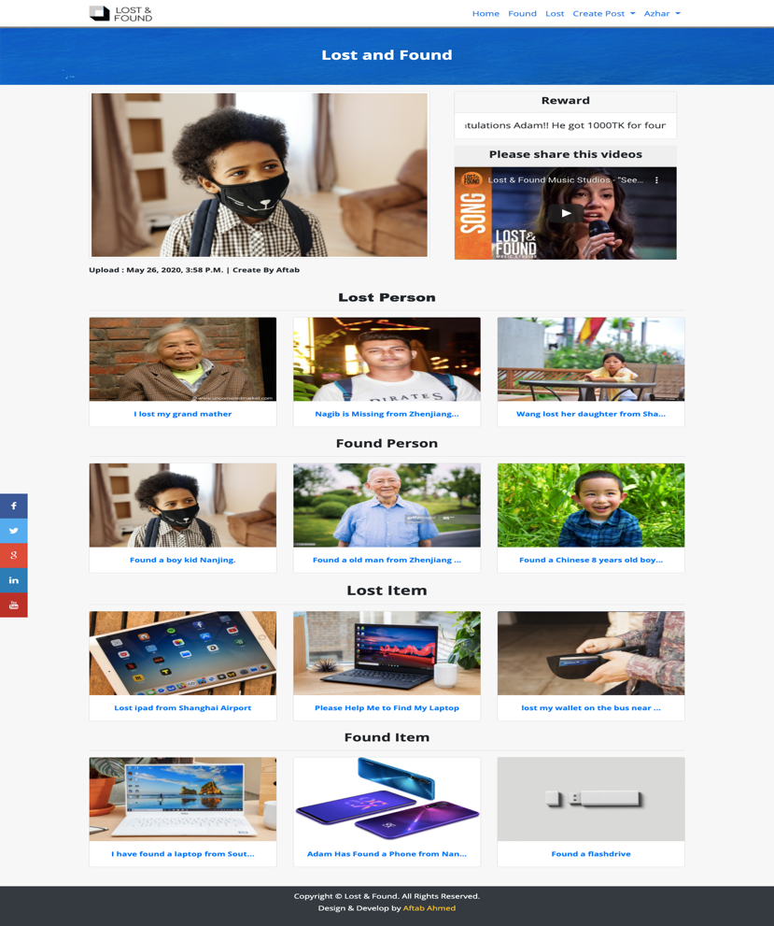
First Page

Slide 19
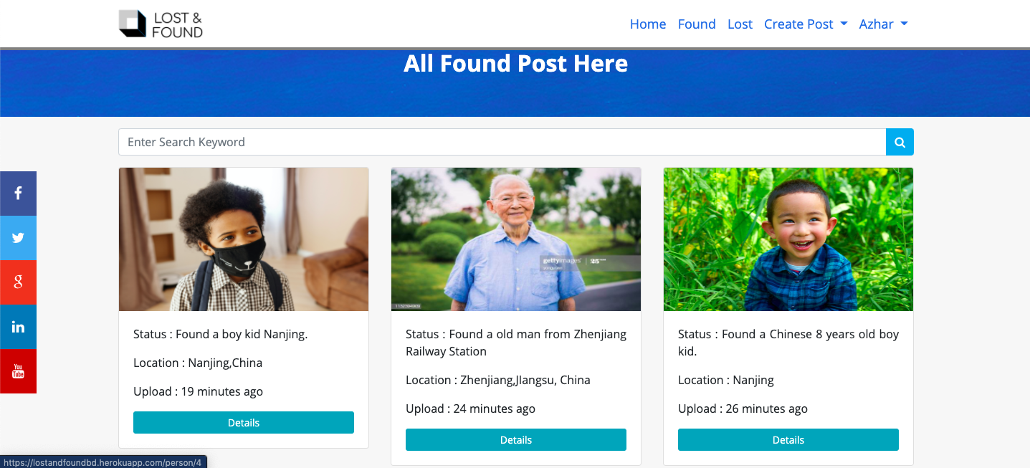
Found Views

Slide 20
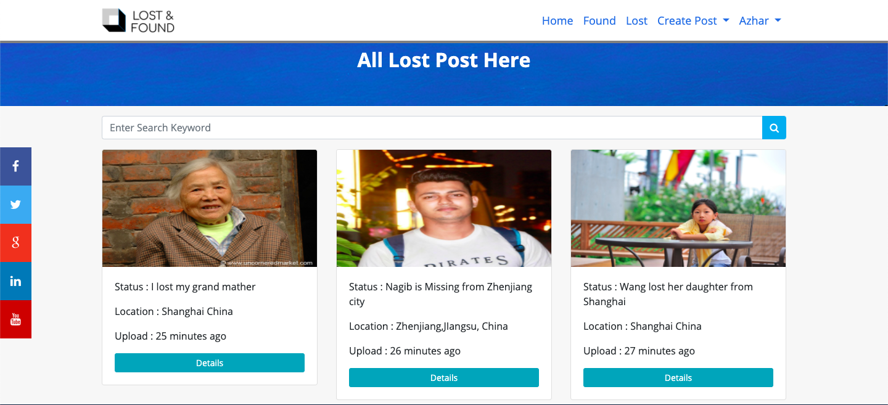
Lost Posts View

Slide 21

Login page View

Slide 22
Tools & Technologies
Python Programming Language (Django Framework)
Postgre SQL
HTML5,CSS3,Bootstrap,JavaScript,Jquery
Lightweight web server
IDE: Visual Studio Code v 1.27.2 and PyCharm

Slide 23
Question?
Notes:
If there are any questions feel free to ask me thanks..

Slide 24
Thank you
Notes:
Questions to Md. Md Aftab Uddin (162910701142)(title: Web Application for Lost and Found)
1. How to get the ER Diagram showed in section 4.3?
In the following diagram we have several entities and for this item and my user and their relationship. The relationship between item and my user is many to one as a use can have items however a Item entity has attributes such as user_Id,Name & Location and much more and myuser entity has attributes such as ID & Gmail and much more.
Rectangle: Represents Entity sets.
Ellipses: Attributes
Diamonds: Relationship Set
Lines: They link attributes to Entity Sets and Entity sets to Relationship Set
2. If a user returns a valuable lost thing, he can win reward. Who gives the reward to user here?
Well good question laoshi, defiantly the owner of the product will give the reward through admin or software owner. Because if anyone gets returns expensive things or person must product will be happy and he willing to give the reward to finder.
3. In my opinion, in this thesis you built a lost and found platform. When a user wants to find a thing that he lost, does it verify the identity of this user?
Well, if anyone lost the product he or she can post on this system with some informative data. for this he or she should sing up and login into the system. When if anyone wants signup into the system he or she should provide some information after that when he or she wants to post into the system also should provide some general and sciret information. Using this information and admin can easily verify the identity the user.

